Slide 1
IEU Programme 3 Away Day
George Richenberg

Slide 2
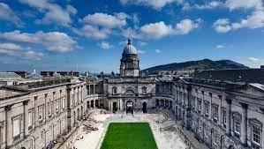
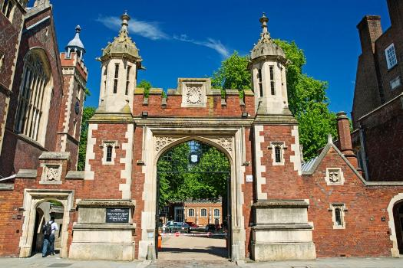
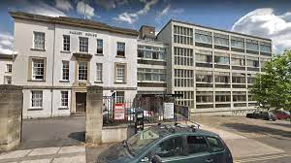
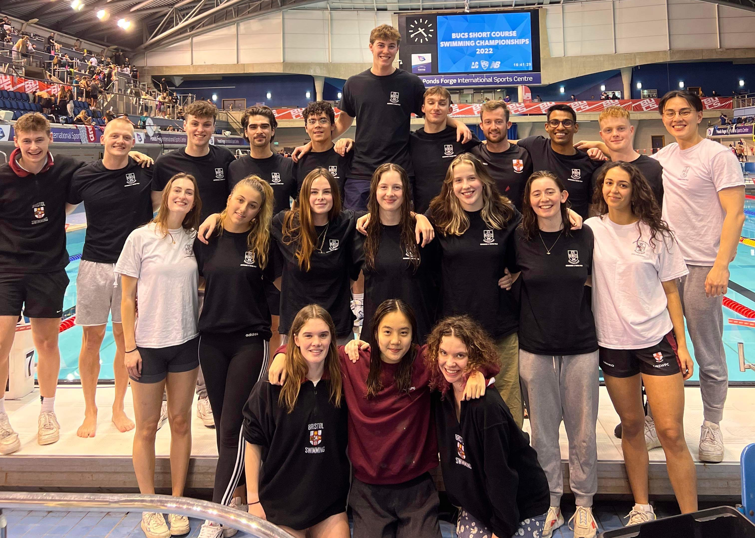
Auto-biography
BSc Biomedical Sciences
2015 - 2019
MSc Genomic Medicine
2020 - 2021
ICEP PhD
2021 - Present

Slide 3


My research motivations
My enjoyment for research
Nutrition
Gut microbiome
Immune system
Cancer risk

Slide 4
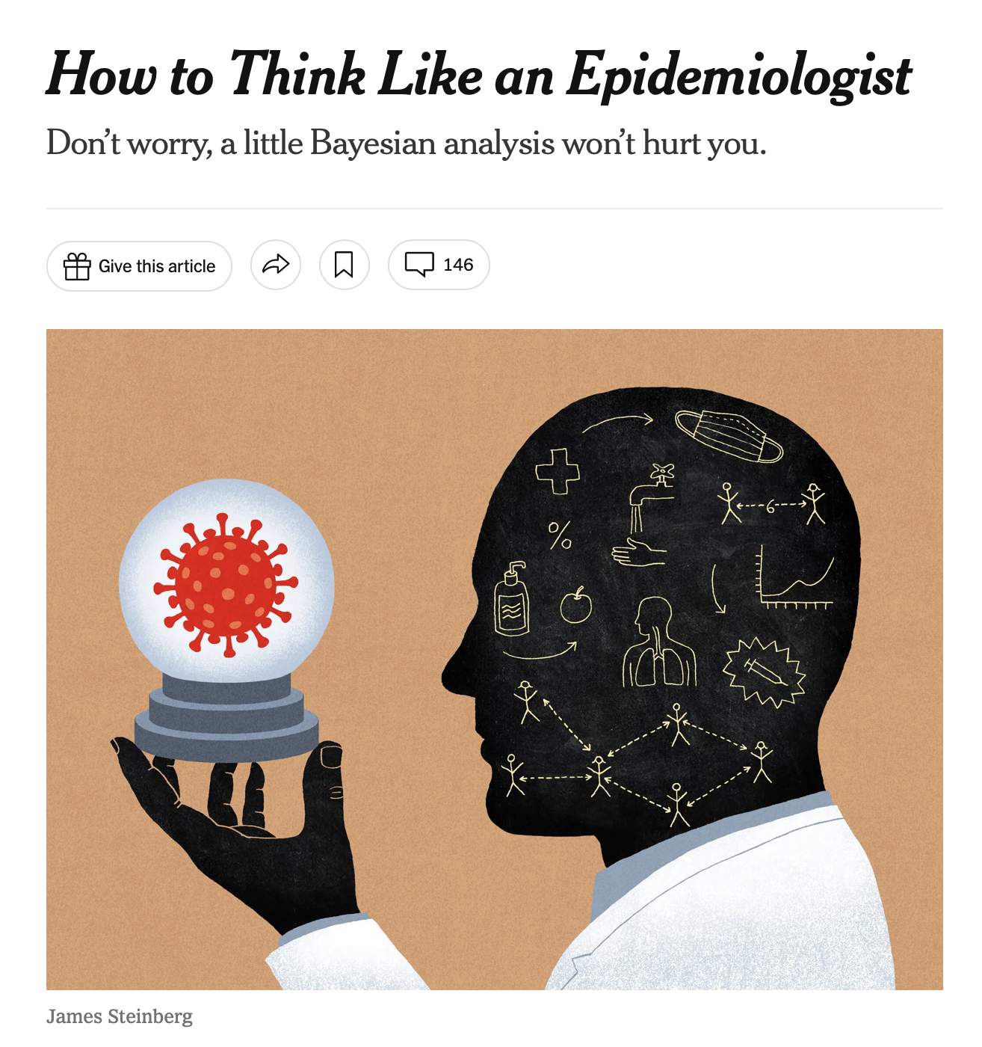
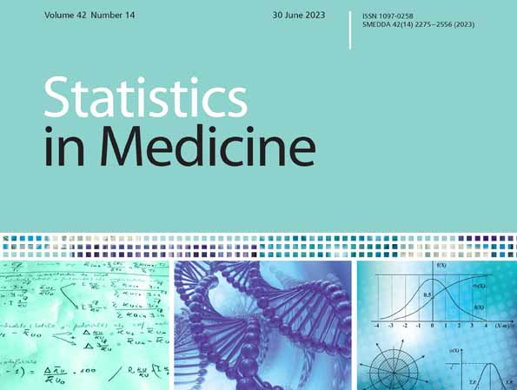
My next (and current) big challenge

Slide 5
A haiku of my research
Rising BMI,
Endometrial cancer's cause,
Hidden pathways found

